Slide 1

Push Notifications with Firebase Cloud Messaging
Presented By: Daavid Sinclair

Slide 2


Push Based Notification
A push notification is a message that pops up on a mobile device. App publishers can send them at any time; users don't have to be in the app or using their devices to receive them.

Slide 3
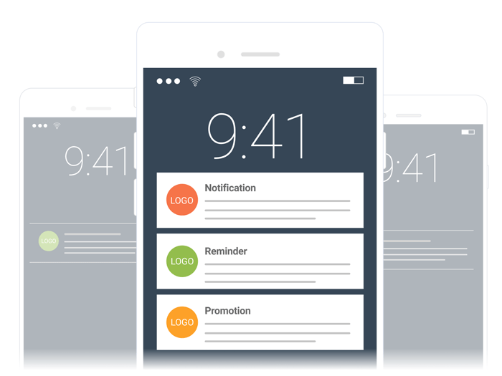
Firebase Cloud Messaging
Firebase Cloud Messaging (FCM) is a cross-platform messaging solution that lets you reliably send messages at no cost.

Slide 4
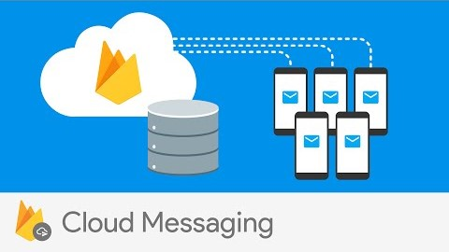
Breakdown of FCM

Slide 5
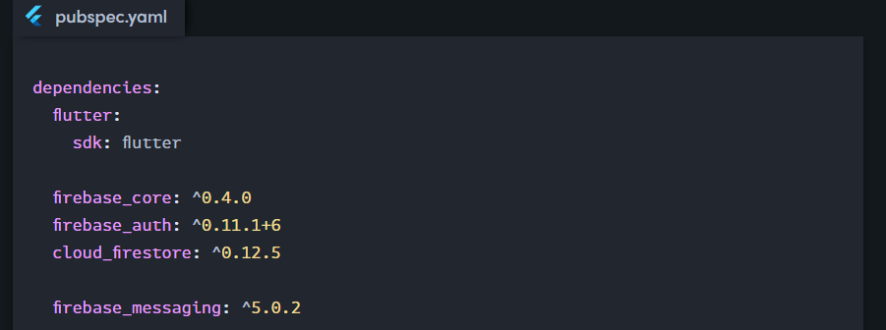
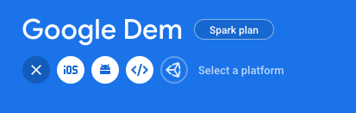
Prerequisites
Step 1 – You need to integrate Firebase into your Flutter App. (Via Google Firebase Console and get google-services.json files)
Add the dependencies to your pubspec.yaml

Slide 6
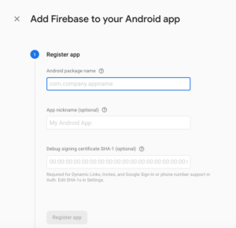
Registering the Application
Step 1
Create the Application on the Firebase Console.
Step 2
Find the SHA Certificate on your local device.
keytool -list -v -keystore C:\Users\user.android\debug.keystore -alias androiddebugkey -storepass android -keypass android
Step 3
Enter your package name and SHA certificate and register the App.

Slide 7

Let’s take a look at the code!

